Slide 1
Deepfake Detection
Guidance
under
Prof. Dr. Chaojie (Jay) Wang
By:
Anuhya Reddy Surakanti

Slide 2
Contents
Introduction
Objectives
Data
Models Applied
Results
Streamlit Application
References

Slide 3
Introduction
The challenge of identifying fake photos or videos created with deep learning techniques is called DeepFake Detection.
Deepfakes are produced by manipulating or replacing certain elements of an original video or image, like a person's face, using machine learning algorithms.
Finding these kind of alterations and differentiating them from authentic videos or images is the aim of deepfake detection.

Slide 4
Objective
The main aim of the project is to apply the following models on the dataset and evaluate the accuracy of each model on validation and test datasets and observe which model is best fit for the dataset:
Convolutional Neural Networks
ResNet
VGG

Slide 5
Data
Dataset is obtained from the source Kaggle: "https://www.kaggle.com/datasets/manjilkarki/deepfake-and-real-images/data"
Dataset contains Train, Validation and Test Images along with annotations.
This dataset is designed with face-wise rich annotations explicitly for face forgery detection and segmentation.

Slide 6
There are two classes: Fake and Real.
The size of the dataset is 46.7MB
There are 610 training images
900 validation images
2410 test samples

Slide 7
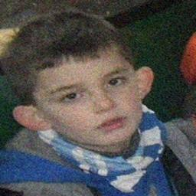
Data Preprocessing
Dataset is downloaded in the form of images and its respective labels.
Ex: real_290.jpg
Each label represents whether the image is real or fake.
All images in the dataset are preprocessed and resized to a resolution of 256 x 256 image of a human face which is either real or fake.

Slide 8
Models Applied
CNN :
A Convolutional Neural Network (CNN) is a deep learning method that is especially useful for picture detection and processing. It consists of several layers, including convolutional, pooling, and fully linked layers.
CNN design is inspired by visual processing in the human brain, making it ideal for collecting hierarchical patterns and spatial connections inside images. CNNs are widely used in areas such as image classification, object detection, facial recognition, and medical image analysis.

Slide 9
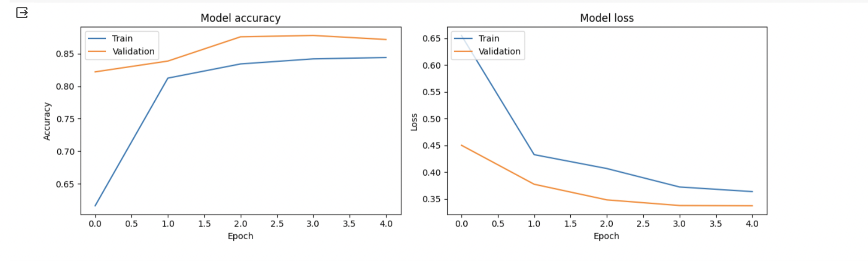
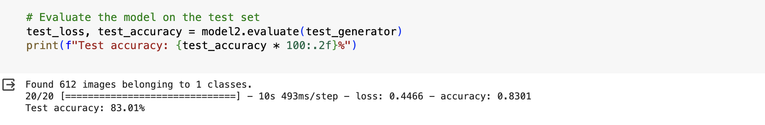

Slide 10
ResNet
ResNets (Residual Networks) are a type of deep learning technique that is particularly useful for picture recognition and processing applications.
ResNets are notable for their ability to train extremely deep networks without overfitting. ResNets are commonly utilized in keypoint detection activities. Keypoint detection is the process of identifying certain points on an object in a picture.

Slide 11
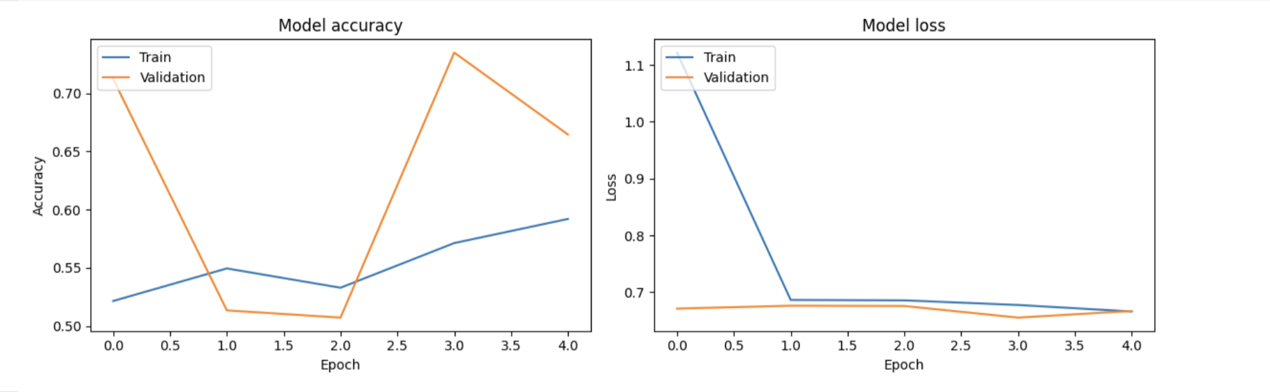
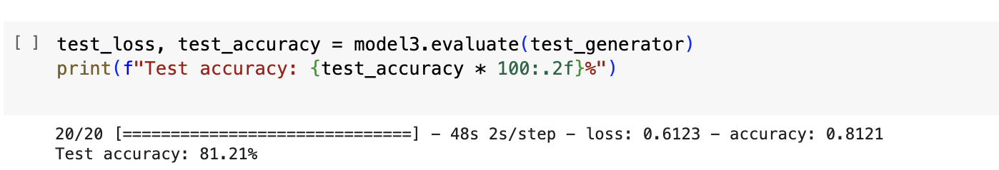

Slide 12
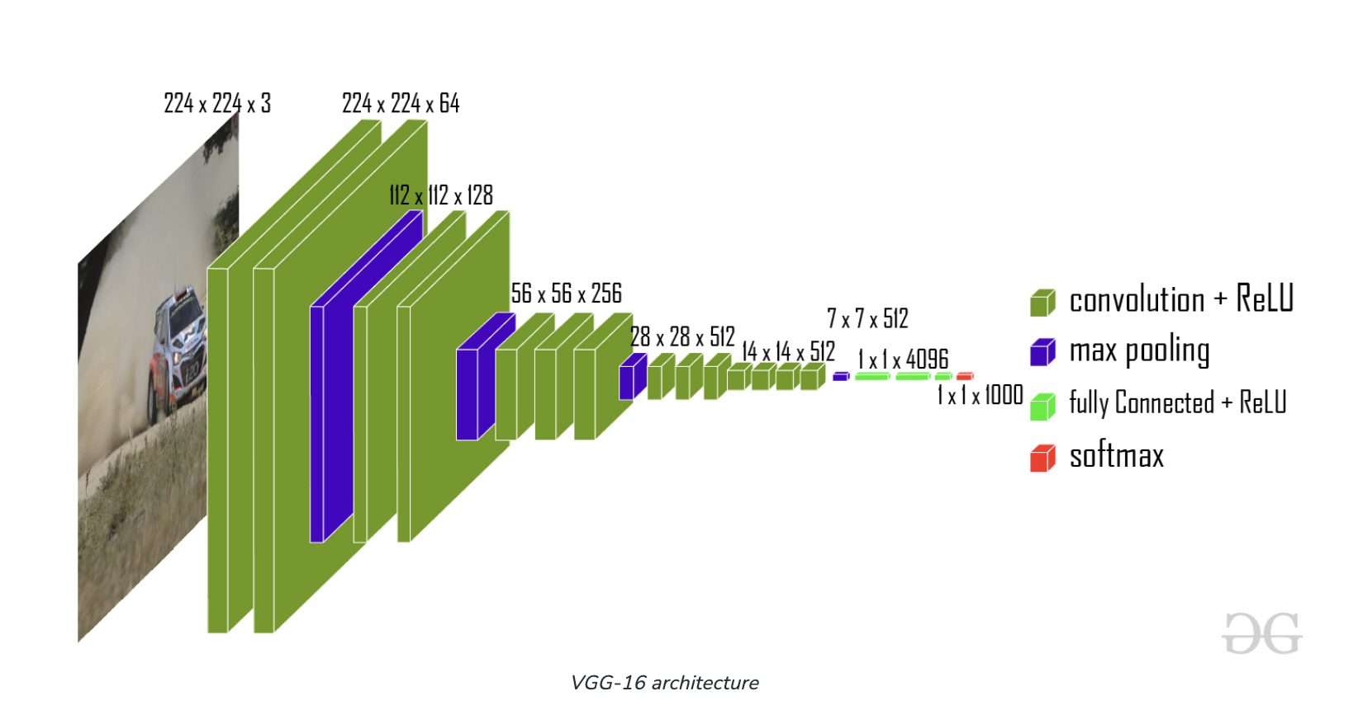
VGG
VGG is a convolutional neural network (CNN) that is noted for its simplicity and efficiency. VGGs typically consist of a series of convolutional and pooling layers, followed by a few fully linked layers.

Slide 13
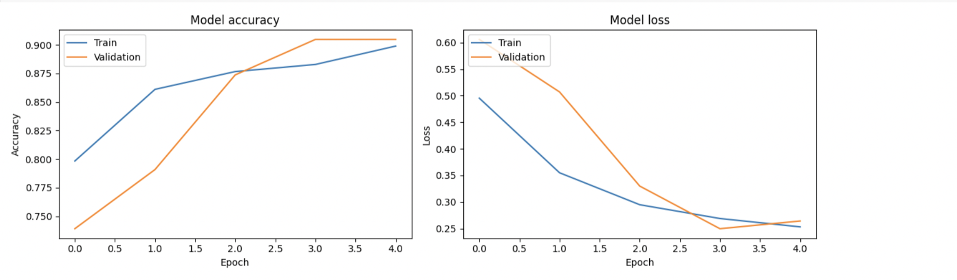
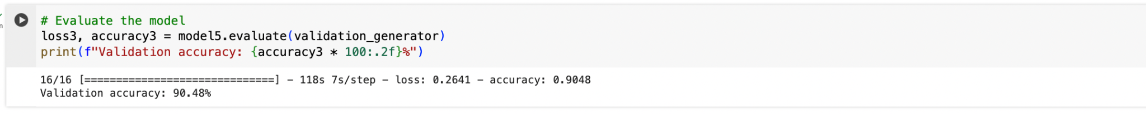

Slide 14
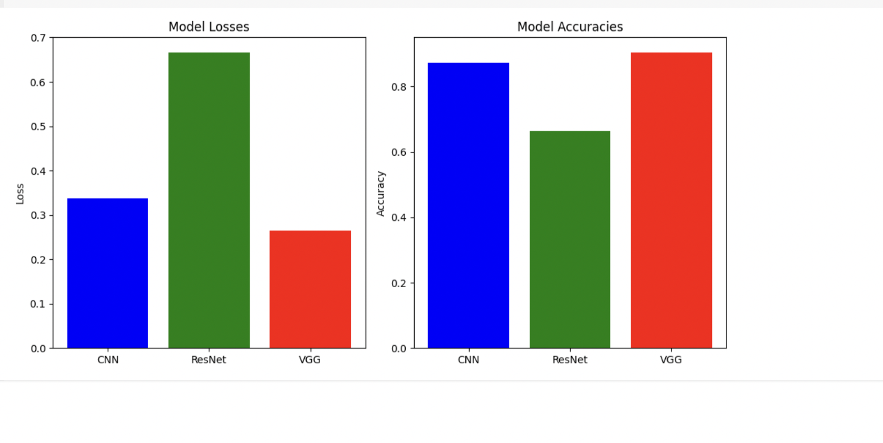
Results:
The three models are evaluated on the test and validation datasets and the accuracy obtained from both are compared among the three models.

Slide 15
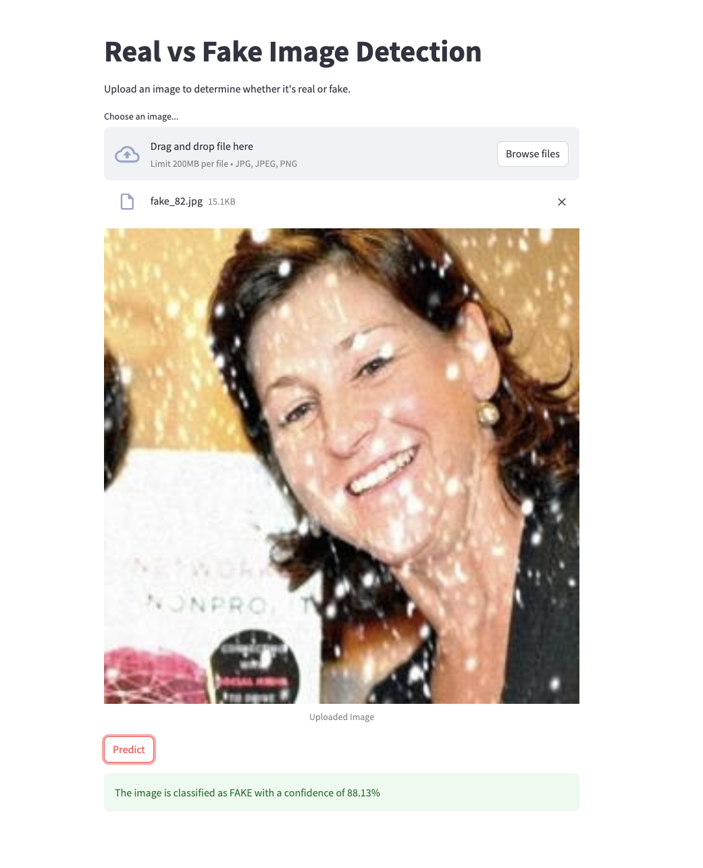
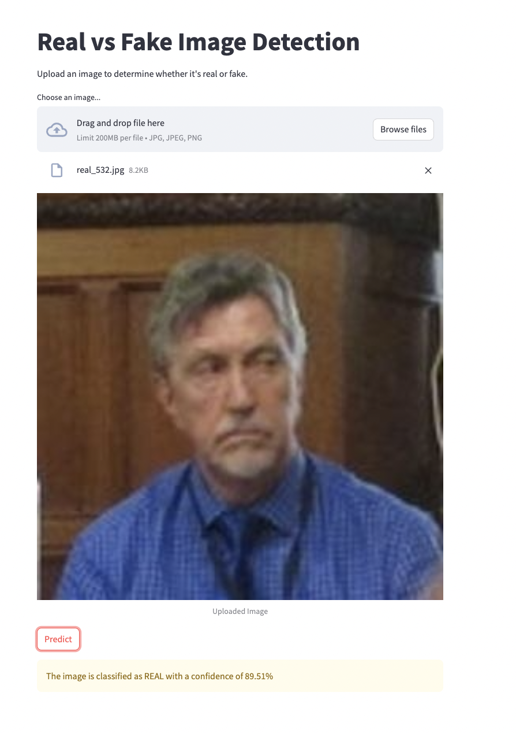
Streamlit Application

Slide 16
References
1.https://www.gao.gov/products/gao-24-107292
2. https://ieeexplore.ieee.org/document/9105991
3. https://www.pnas.org/doi/10.1073/pnas.2110013119

